Slide 1
Big mountain Resort Pricing Analysis
BIG MOUNTAIN RESORT
Data ANALYSIS

Slide 2
Context - A char lift recently installed - Costs $1,540,000 - Premium charge preferred Success Criteria - Raise ticket price - Increase revenue - Cover the costs - Within 1 year
BIG MOUNTAIN RESORT
PROBLEM STATEMENT
Constraints - Insufficient capitalization on facilities Data Sources - CSV file from the database manager

Slide 3
Problem Statement How can Big Mountain Resort select a better value for its ticket price without undermining the ticket price or supporting an even higher ticket price over the year?
BIG MOUNTAIN RESORT
PROBLEM STATEMENT
e.g.
- Closing runs?
- Reducing the number of fast chairs?
- Making more snows via machines?
- Increase the night skiable area covered by lights?
- Increase the vertical drop?
…

Slide 4
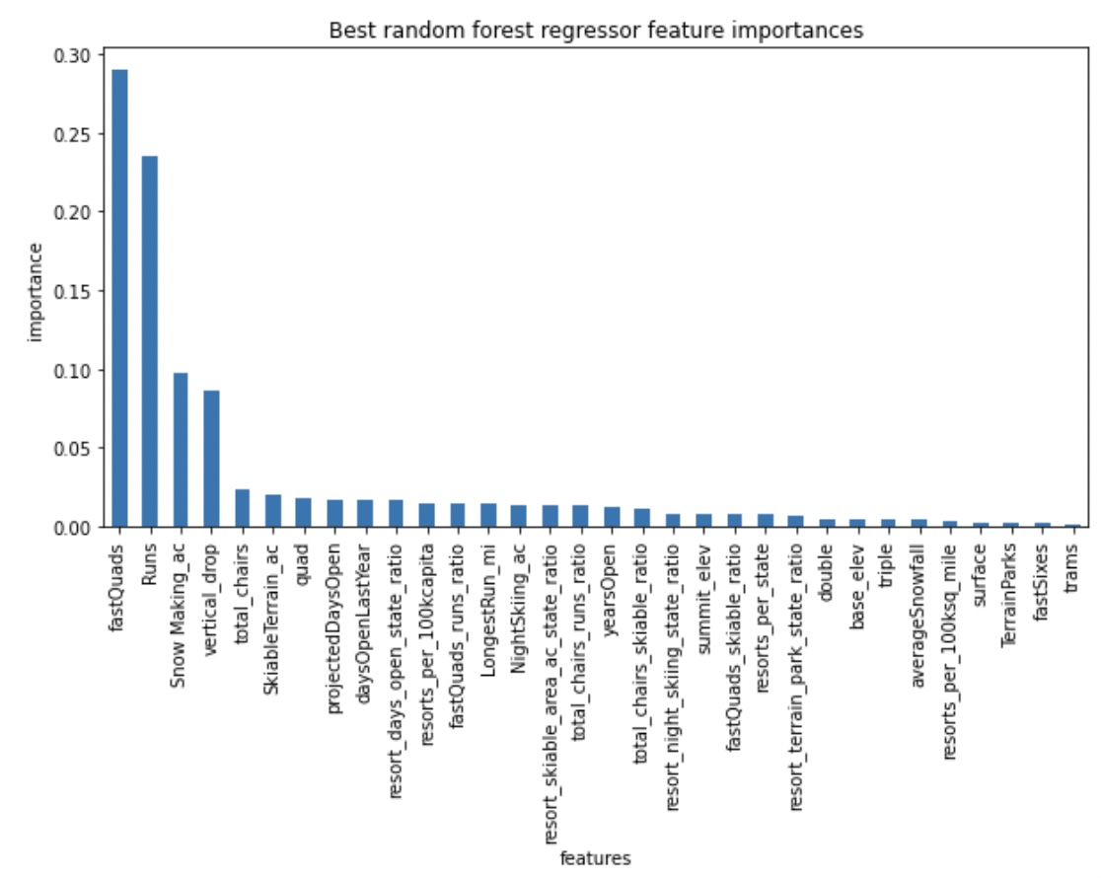
Key Findings
Big Mountain Resort
Key findings
Based on the model (Random Forest):
The expected ticket price for Big Mountain is $98.74
Current price is $81.00
Mean Absolute Error is $10.30
(*** Adult Weekend Price is our target)
-- > room for increasing price!
Top features:
`fastQuads`, `Runs`, `Snow Making_ac`, `vertical_drop`

Slide 5
Results & Analysis
Big Mountain Resort
ResulTs & Analysis
8 features affect pricing mostly (Cross Validation):
vertical_drop | 10.767857
Snow Making_ac | 6.290074
total_chairs | 5.794156
fastQuads | 5.745626
Runs | 5.370555
LongestRun_mi | 0.181814
trams | -4.142024
SkiableTerrain_ac | -5.249780
Lets put Big Mountain in the market context!
Lets see where Big Mountain sits for some of the top features that are related to AdultWeekend Price!

Slide 6
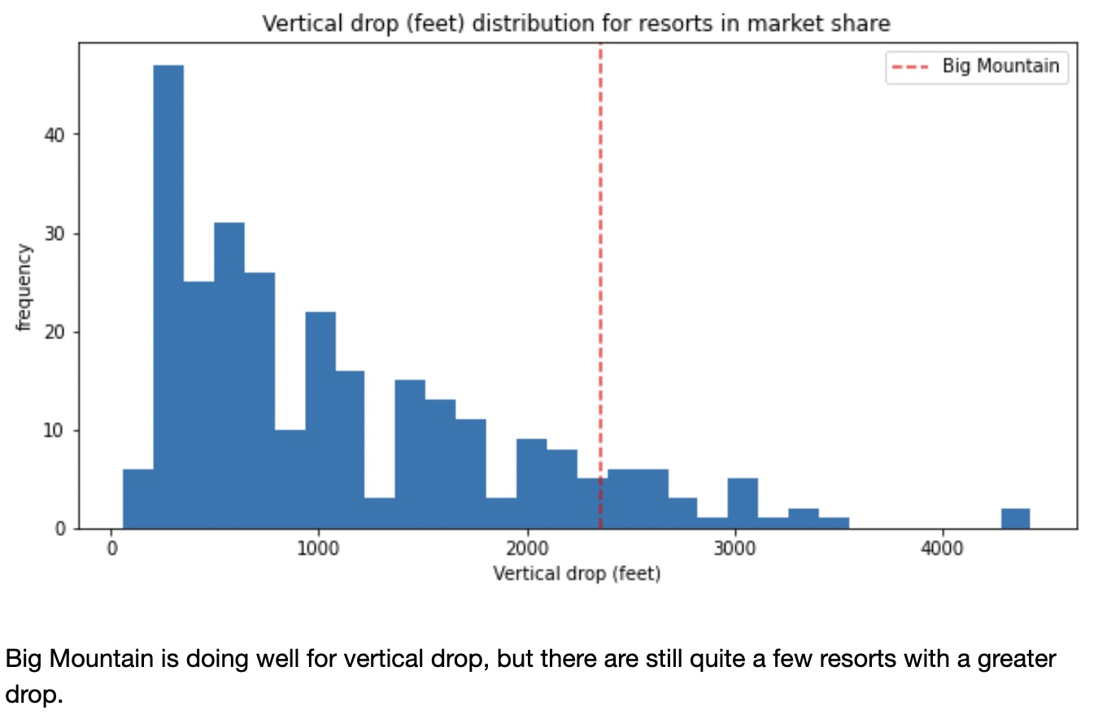
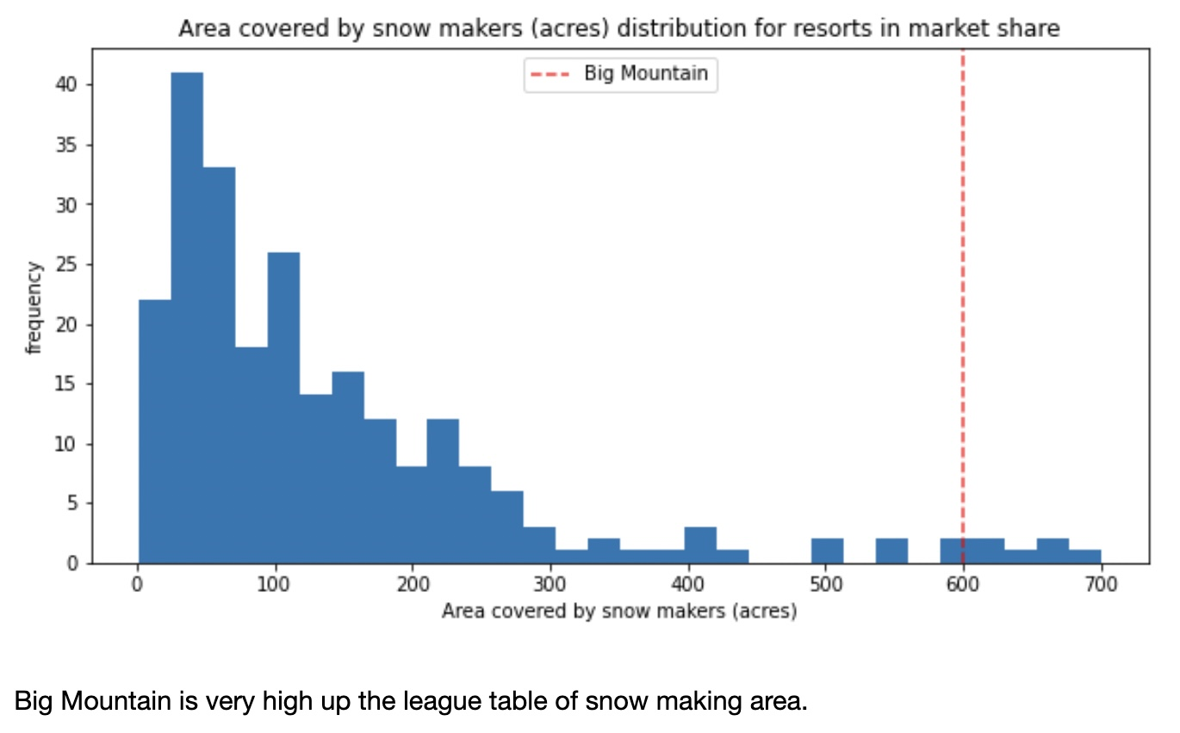
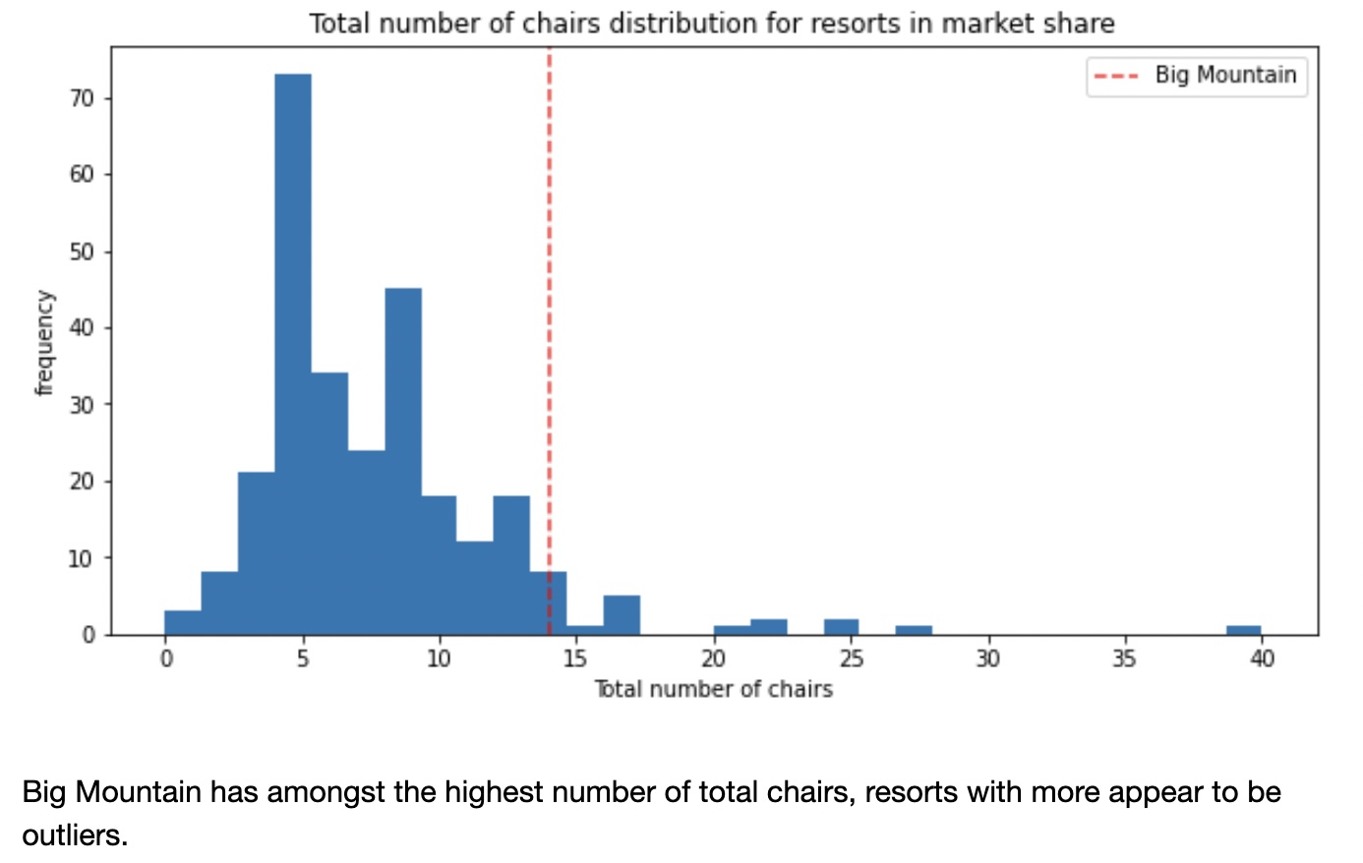
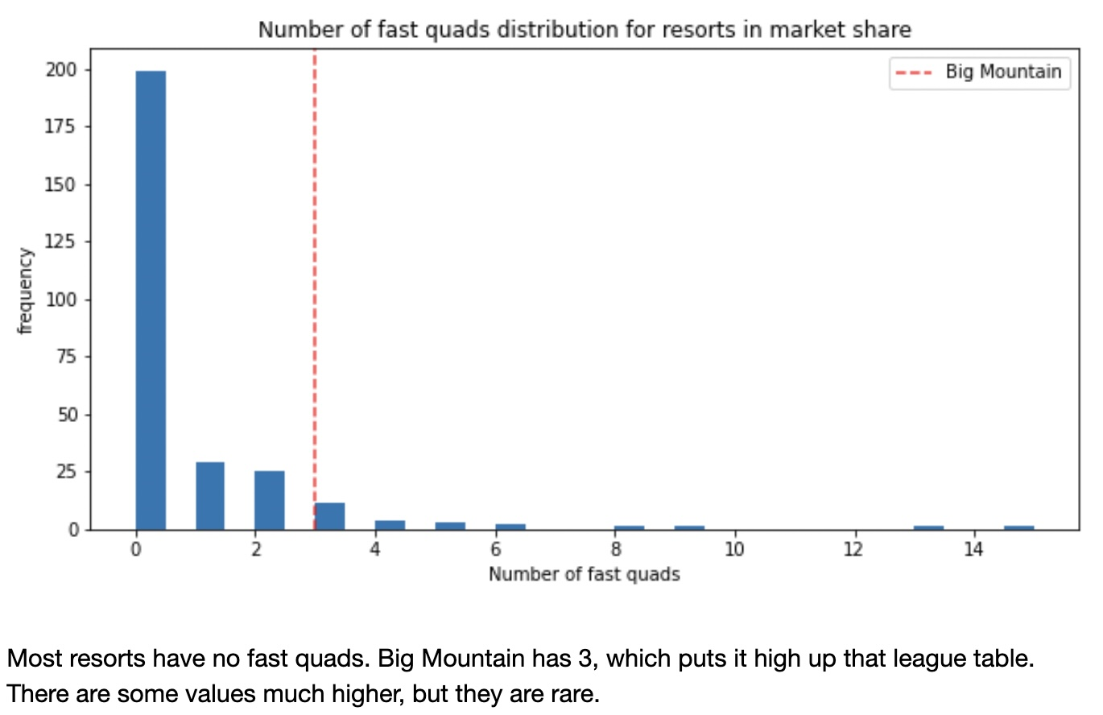
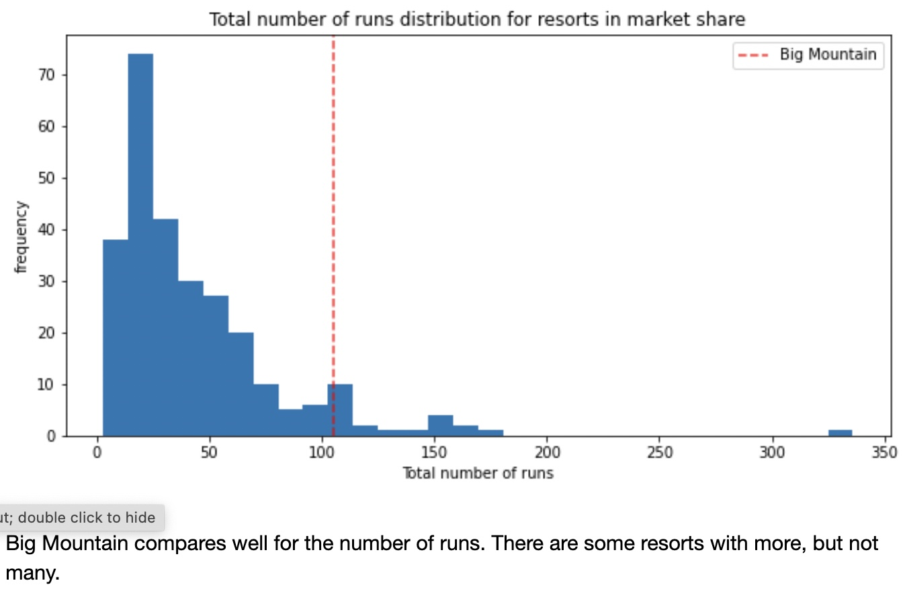
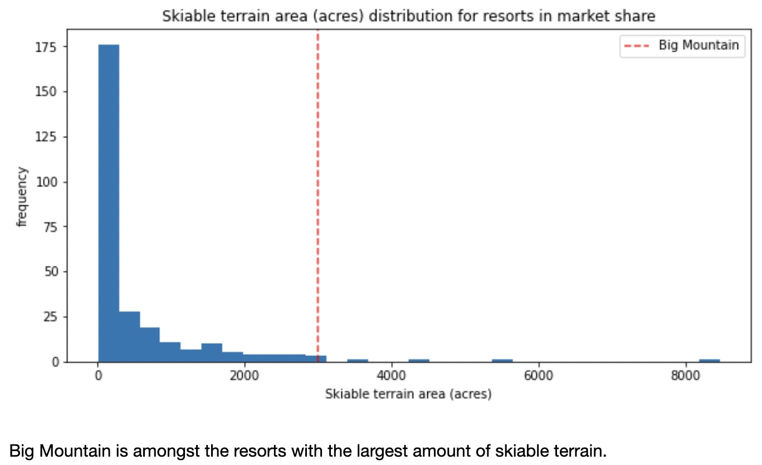
Results & Analysis
Big Mountain Resort
ResulTs & Analysis

Slide 7
Results & Analysis
Big Mountain Resort
ResulTs & Analysis
Scenario Analysis:
Scenario | Results
1. Close up to 10 runs | Close 2 runs is optimal
2. Increase vertical drop by adding a run to a point of 150 feet lower down, with an additional chair lift | Increase ticket price support by $1.88, and revenue by 3.3 million
3. Same as number 2, but adding 2 acres of snow making cover | No difference than number 2
4. Increase the longest run by 0.2 mile and add a snow making coverage of 4 acres | No effect on ticket price and revenue

Slide 8
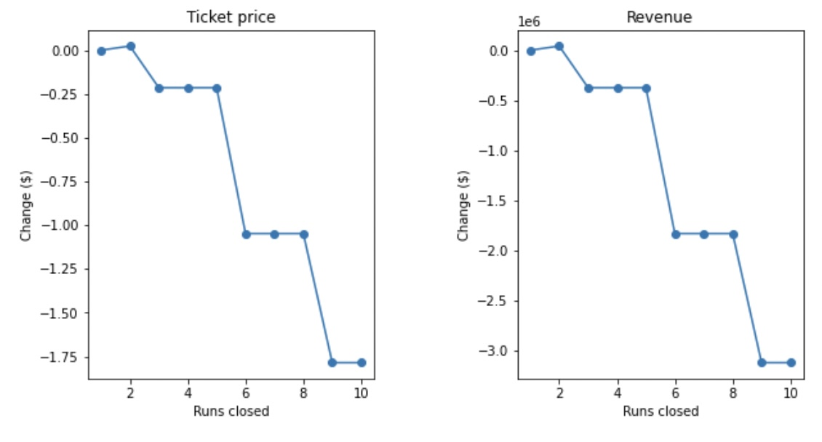
Results & Analysis
Big Mountain Resort
ResulTs & Analysis
Close one run | No impact
Close 2 runs | Increase support for ticket price and revenue
Close 3, 4 or 5 runs | Same loss in ticket price and revenue
Close 6 or more | Large drop in ticket price and revenue
Scenario Analysis (cont.) -- > more on closing runs!

Slide 9
Conclusion
Big Mountain Resort
Conclusion
Based on the model (will be discussed next), Big Mountain Resort should:
Start to close 2 least used runs at first
Increase the vertical drop by adding a run from 150 feet lower down with an additional chair life -- > ⬆️ $1.88 in ticket price & 3.3 million in revenue over the season
Secondary options:
Increase the vertical drop further (e.g., by 200 or 250 feet)
Close more runs (up to 5)

Slide 10
THANKS!
Big Mountain Resort
Data ANALYSIS
Do you have any questions?
banqu@buffalo.edu
+1 416 553 2036

